Slide 1

ELLIPSIS TECH SERIES 2022:
TEAM SILVERBOYS PITCH DECK
DEMETER

Slide 2
Target Audience
Non-banking companies
E.g.
Who have a sizeable presence in the rural communities all around the world.
We want to empower them with a financial services infrastructure on the cloud so that they can disrupt traditional banking in their local area.
Telecom companies in rural communities, such as suburban areas in Latin America.

Slide 3
Our Proposed Solution
A console to integrate finance-related services to their end-consumer facing applications
To disrupt the current financial infrastructure in untapped markets, or in markets that are gaining traction.

Slide 4

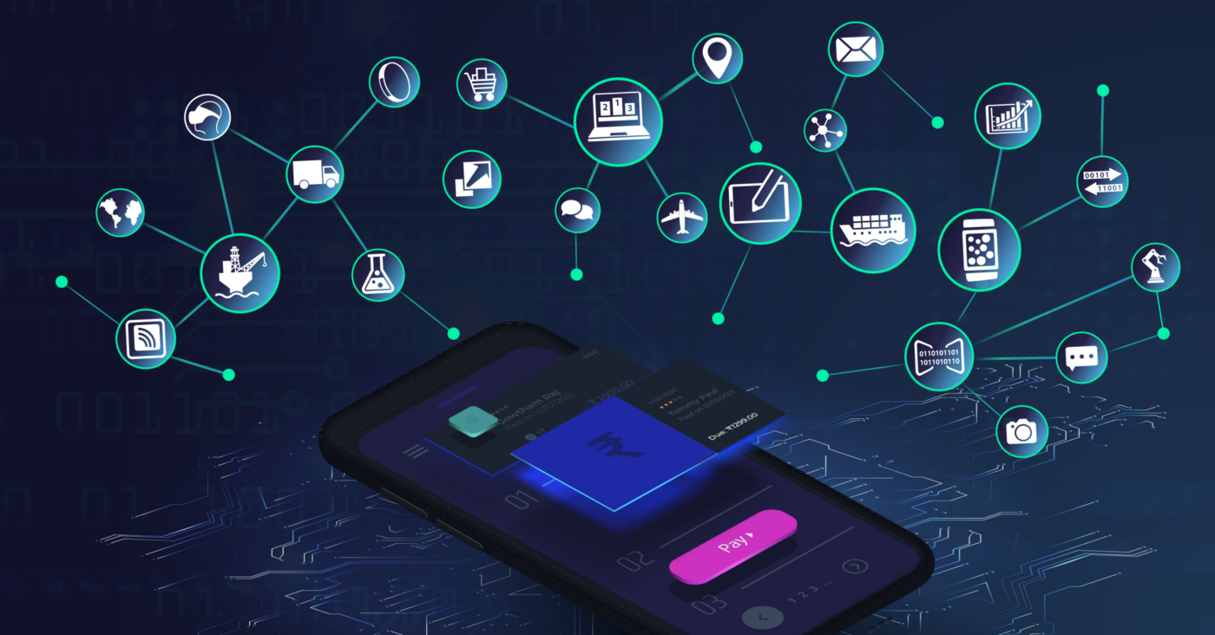

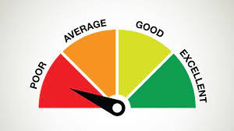


WHAT WE PROVIDE
EMBEDDED BANKING SERVICES
PEER-TO-PEER LENDING
CREDIT SCORING MODEL
Allow access to traditional banking services like offering loans, interest rates
Helps our clients create their own P2P lending platform
A machine learning model that predicts creditworthiness based on track records

Slide 5


WHAT WE PROVIDE
FRAUD DETECTION
DASHBOARD
Leverage on Goldman Sachs’ analytics tools and data team to detect suspicious transactions
Transaction heatmap, analytics, insights, loaning, P2P lending

Slide 6
BUSINESS USE CASES
Automation
Insights
Improve process of provisioning financial services
Improve data aggregation and analytics methodologies

Slide 7
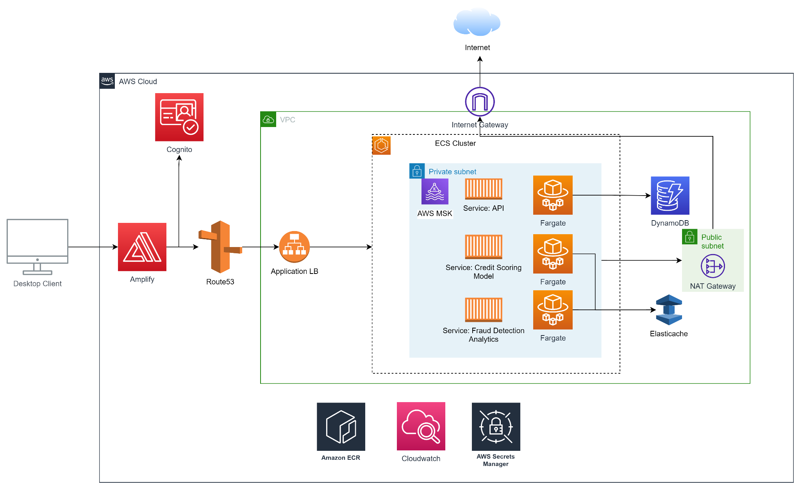
SOLUTION ARCHITECTURE

Slide 8
TECH STACK & FRAMEWORKS
AWS Amplify & Cognito
React, Express.js and Associated Libraries
AWS ECS/ECR
Python, Flask, scikit-learn
Serverless Framework with ECS Fargate
Login Authentication
UI for clients to interact with Goldman’s cloud tools
Host analytics tools; AWS MSK for scalable message queues; AWS Elasticache for caching
Leveraging on surprised learning techniques
Backend APIs

Slide 9
DEMO

Slide 10
WHY DEMETER
1.7 billion people in the world with access to the internet but without access to banking services
Create opportunities to be a pioneer in disrupting traditional finance in rural areas
Improving financial inclusion in those areas
Notes:
Rural areas like Latin America, Africa, Middle East, Southeast Asia

Slide 11
Future work
Additional services
Improving current services
Architecture
Provide a full stack application creation service
A service to create and manage a banking mobile application
Provide other banking services
Credit rating
Provide models that are more specific to use cases
Leverage on continuous training with current data
Fault detection
Allow users to set their own business rules and alarms
Use unsupervised models for future fraud
Implement caching on API calls to improve latency
Use Kafka messaging queues for business-critical communication
Implement microservices architecture for each service

